Slide 1
IoT Management System (Initial Presentation)
Team 2

Slide 2
CONTENTS
Overview
Project Scope
Architectural Drivers
Project Strategy
Design

Slide 3
1. Project Overview
Overview
Our Team is working for an organization that intends to enter the IoT market.
We make an Internet of Things(IoT) system that enables end-users to communicate with sensors and actuators installed in the home or business via PC or smartphone connected to the internet.
(For example, indoor and outdoor light, temp and humidity sensor, door open-close actuator, door open-close sensor, secure alarm, presence/proximity sensor)
Notes:
DBR2 : 센서 / 엑츄에이터 예제 서술
DBR3 : 센서 구조 예제 그림 그리기

Slide 4
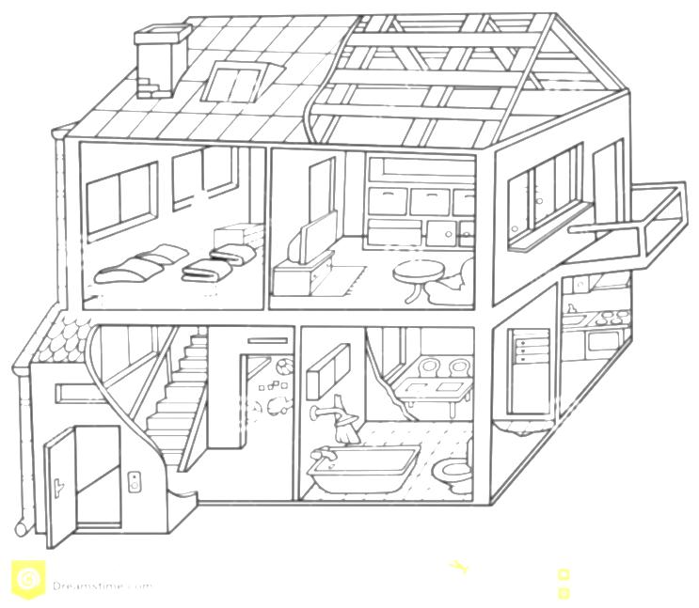




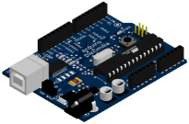



1. Project Overview
Environment of project
The home or business uses the internet with standard Wi-Fi router.
Sensors / actuators can connect to the home or business network with Arduino microcontroller enabled Wi-Fi.
Temp.
sensor
Presence
Sensor
Light
Secure Alarm
Humidity
sensor
Arduino
Door
Open-Close
Wi-Fi
router

Slide 5
2. Project Scope
2.1. Context
2.2. Stakeholders
2.3. System Context Diagram

Slide 6
2.1 Context - Market, Organizational
Market Context
Stakeholders | Customer, End-user, System Installer, Developer
System Access | Users want to access the system via PC, Mobile devices
Functional expectations | After system installation, users expect the system to work automatically by assigned rules of sensors and actuators
Environment | There are many vendors developing a system, sensors and actuators. But there is no standard of interface.
Organizational Context
Roles and responsibilities | Project Manager(includes planning, risk and configuration, schedule) Architect Requirement Manager Test Manager Documentation Manager Developer (all members)
Technical background | Digital-Appliance SW solution researcher & developer Smart-phone SW developer Camera module testing SW developer
Notes:
DBR4 :Any more assumptions? Such as using commonly found sensors, actuators to reduce cost? Using open source apps. Would the browser be different for mobile devices and PC's :
DBR5 : How about planning manager, risk manager, configuration manager, customer liaison? If you sourced these roles from a framework then which one?
DBR6 : Very broad. Can you be more specific, consumer durable goods, or IT or government products?

Slide 7
2.1 Context - Business, Technical
Business Context
Date of Delivery | 26 June 2015
Time Resources | 498 man-hours (48+450) :48 man-hours (8 hours X 6 people) in Korea :450 man-hours(3 hours X 6 people X 5 days X 5 weeks) in CMU
Strategy | Easy to use & high extensibility for sensors/actuators
Target Market | B2B - Building Architect Office, B2C - DIY User
Profit Model | Rental Service, Standalone, System Education, Maintenance
Future direction | Many kinds of sensors/actuators(indoor air quality sensor, camera, thermostat controller and so forth) is used & it makes a lot of use case. So big-data of these cases would enable to make services of IoT System.
Technical Context
Development Skills | Java , C, JavaScript, HTML5
Platforms | Arduino Platform, Laptop Computers
Tools | Eclipse, Arduino IDE
OS | Windows, Linux
HW platform | Arduino , X86
Notes:
DBR7 : May be better to consider hours here instead of 7 weeks. Would that be a better measure of to use for determining what you can get done?
→ working day 3hours, Weekend 8hours
DBR8 : Such as? Examples
→ 센서 : 조도 센서, 거리센서, 컬러 스펙트럼 센서 , 카메라
→ actuator : 온도 조절기 , 조도 조절기 , ????
DBR9 : this is good to consider technical risks early.

Slide 8
2.2 Stakeholders
Stakeholders of the IoT Management System (IoTMS)
Customer
End-User
System Installer
Application Developer
Value-added-resellers (VARs)
Service Provider
Maintainer
Project consultant (or mentor)
Notes:
DBR10 : How about project consultant, or mentor too?
DBR 11 : Good, but usually in the US we spell out the acronym first and then in parens give the acronym. As is this is OK

Slide 9



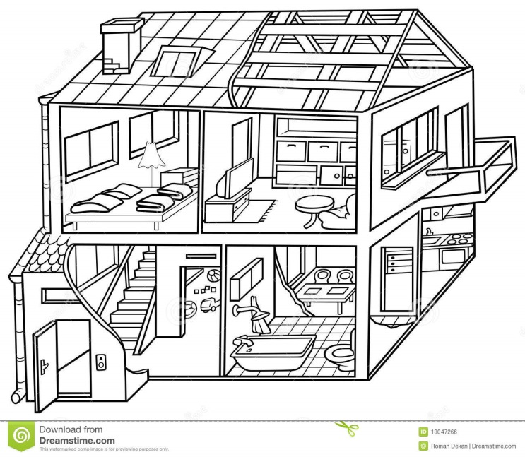





2.3 System Context Diagram
System Context
Interaction between key stakeholders and the IoT Management System (IoTMS)
Customer / End-user
VARs
Control&
monitor
Serve IoT
Environment
Resell
Maintain
System
Maintainer
IoTMS
Install
System
SA Node
Develop
System Installer
Provide service
Sensor/Actuator
Server
Developer
router
Service Provider
Notes:
DBR12 : Will the service provider be the same person as the developer?

Slide 10
3. Architectural Drivers
3.1. Function Requirements
3.2. Use Case Analysis
3.3. Constraints
3.4. Quality Attributes

Slide 11
3.1 Functional Requirement
Req. ID | Description
FR-01 | The system provides a secure service (e.g. authentication, authorization, accounting) that allows users to query the home to find out how many nodes are installed and what sensors/actuators are installed on each node.
FR-02 | The system provides a secure service that allows users to determine the temperature/humidity, turn on and off lights, open and close the door, turn on the alarm, and determine if anyone is home.
FR-03 | The system should store sensor values and log all user commands for some period of time (e g. a configurable sliding window of data with 72 hours as the default value, minimum 8 hours) and allow user applications to review their sensor and command history in a secure and private way.
FR-04 | The system should not allow unauthorized persons to access the home sensors/actuators, or access any data generated by them, or any data stored in the system.
FR-05 | The system should not allow unauthorized persons to register a sensor that they do not own
FR-06 | The system should send an emergency message when the door is manually opened while alarmed or the house is suddenly occupied while alarmed.
FR-07 | The system should not allow automatic door opening while the house is alarmed. The alarm must be disabled prior to opening the door.
FR-08 | The system should send a message to the user to inform them when the house is vacant and not alarmed. It should ask them if they want to alarm the home. If they do not respond within 5 minutes (configurable, 5 minutes is the default value - feel free to shorten this to a few seconds for test and demonstration purposes) the house will lock itself. If a door is open, it will automatically close the door before alarming the house.
Notes:
DBR13 : You will need to further define this. What is a "secure service" and how secure does it need to be.
DBR14 : Good, but you probably will need to put in a minimum amount that the customer desires...or does this imply that the storage time should be configurable by the user.

Slide 12
3.1 Functional Requirement
Req. ID | Description
FR-09 | The system should automatically turn off the lights when no one is home and 10 minutes elapses (configurable, 5 minutes is the default value - feel free to shorten this to a few seconds for test and demonstration purposes).
FR-10 | It should be easy for users to add and remove nodes to and from the system without having to restart the system or other nodes (you will have to demonstrate this). This includes secure registration and recognition of the type of sensors and actuators provided by the node.
FR-11 | The system should make it easy for application developers (private persons, VARs, or other 3rd parties) to build custom apps, services, and/or make mashups from existing available services (you should describe how the design supports this).
FR-12 | The system should make it easy for developers to implement new protocol about new devices.
FR-13 | The system provides user define scenario service like IFTTT(IF This Then That)
FR-14 | When the system sends emergency message, it will be E-mail. In future, it can be SMS or tweet.
FR-15 | When sensors value is abnormal(out of range), the system sends an alarm message to user.
FR-16 | User sets configurations of E-mail address, logging-duration, secure response time and lights waiting time.
FR-17 | The system provides Web APIs for Web developer.
Notes:
DBR15 : added by whom

Slide 13
3.2 Use case text
Do-It-Yourself(DIY) User buys IoT System and IoT products at Home Depot.
The user installs sensors and actuators at the proper place such like door, room, terrace and so on. Although the user doesn’t have any experience installing such devices, the user can install following user-manual.
And user installs IoT software in own PC. And then user connects SA Node to Internet router and registers the node in IoT Software after log-in.
After the registration, user checks sensors and actuators if they works or not.
In addition, user makes a custom rule and puts it into IoT system.
After all, user reviews sensors and command history.
Notes:
DBR17 : Interesting that the user could also be the installer. Is there some minimum amount of expertise required?

Slide 14
3.2 Example of Use Case Scenario
Use Case Title : Query nodes and sensor/actuators | Use Case ID : UC-01
General use case description: This use case describes how to query nodes and sensors/actuators on each node information by user in a secure way
Entities involved: User / IoT Management System(IoTMS)
Preconditions User has registered in IoTMS using register menu
Primary use case flow of events: 1. User logs in IoTMS using by user’s ID and Password 2. IoTMS allows user to access System 3-1. User queries nodes information to IoTMS A. IoTMS returns number of nodes to User. B. User selects a node which user wants to know detailed information. C . IoTMS returns sensors/actuators information in the node to User. D. repeat B-C until user ends detailed query 3-2. User queries whole nodes information to IoTMS A. IoTMS makes list of nodes and sensor/actuators within node B. IoTMS returns list to User. 4. User logs out from IoTMS .
Primary use case post-conditions: User querying is completed
Alternate use case #3-1 1. It is possible to query malfunction nodes and sensors/actuators each node.
Notes:
DBR19 : Why sometimes?
DBR18 : User has registered, or Users have registered

Slide 15
3.2 Example of Use Case Scenario
Use Case Title : Add new rule | Use Case ID : UC-02
General use case description: This use case describes how the system reacts by conditions previously defined
Entities involved: IoT Management System(IoTMS)
Preconditions User has logged in IoTMS . IoTMS manages the list of predefined rule sets.
Primary use case flow of events: 1. User adds a new rule with conditions and actions to IoTMS. 2. Check whether the condition is unique and no collision with registered conditions. 3. If no issue on the condition, IoTMS accepts and applies the rule to predefined rule set. 4. IoTMS displays added rule set to User.
Primary use case post-conditions: It is completed that new rule is inserted into predefined rules set.
Alternate use case #3-1 3.1. If the given condition is already existing or collision with other rules, IoTMS invokes error message with the reason.

Slide 16
3.2 Example of Use Case Scenario
Use Case Title : Review histories of sensors/actuators state and user commands | Use Case ID : UC-03
General use case description: This use case describes how to review user’s sensor and command history by user in a secure way
Entities involved: User IoT Management System(IoTMS)
Preconditions User has registered in IoTMS using register menu
Primary use case flow of events: 1. User tries to log in IoTMS using by user’s ID and Password 2. IoTMS allows user to access System 3. User requests sensors or commands history to IoTMS 4. IoTMS checks that user has permission 5. IoTMS asks period of history what user want to review to user 6. User sends period what user want to review 7. IoTMS makes list of history what user want 8. IoTMS displays list of sensors and commands history to user
Primary use case post-conditions: User Reviewing history is completed
Alternate use case #5-1 5.1. If User cannot login because of incorrect ID/password, IoTMS displays “Find Password” or “Find User-ID” for User

Slide 17
3.2 Example of Use Case Scenario
Use Case Title : Test control/monitor | Use Case ID : UC-04
General use case description: This use case describes how to test control/monitor sensors/actuators after log-in
Entities involved: Secure service
Preconditions User has already logged in IoT Management System(IoTMS).
Primary use case flow of events: 1. User tries to log in IoTMS using by user’s ID and Password 2. User monitors the temperature/humidity. 3. User turns on indoor light. 4. User turns on outdoor light. 5. User turns off indoor light. 6. User turns off outdoor light. 7. User controls door close. 8. User controls door open. 9. User monitors door sensors. 10. User monitors presence/proximity sensor.
Primary use case post-conditions: User logs out to finish access the server.
Alternate use case #1-1 1.1 If user inputs wrong ID or password, system informs log-in fail.

Slide 18
3.2 Example of Use Case Scenario
Use Case Title : Register node | Use Case ID : UC-05
General use case description: Server register node.
Entities involved: Installer, User(Customer), Server, Node
Preconditions Server and node have same serial key.
Primary use case flow of events: Installer or user request register node to server. Server search node. Server display node that can be registered. Installer or user select node. Server register the selected node.
Primary use case post-conditions: Server and node can communicate with each other.
Alternate use case 3.1 if there is no node, display nothing. 3.2 if there is registered node, indicates that registered nodes

Slide 19
3.3 Constraints
Business Constraints
ID | Description
CST-01 | Schedule Limitation: 7 weeks(include a plan-time in Korea) 498 man-hours (48+450) :48 man-hours (8 hours X 6 people) in Korea :450 man-hours(3 hours X 6 people X 5 days X 5 weeks) in CMU
CST-02 | Human Resources: 6 people
CST-03 | User can’t buy SA nodes and sensors/actuators separately.
Technical Constraints
ID | Description
CST-01 | End-user communicates with sensors/actuators via PC or Smartphone connected to the Internet.
CST-02 | An SA node has 1 or more sensors/actuators.
CST-03 | An SA node uses Wi-Fi communication(802.11)
CST-04 | The IoTMS should be made by Java Language & Arduino device
CST-05 | The IoTMS works on PC or Server
Notes:
DBR21 : As recommend use hours, may be a better granualrity. Weeks implies a work week of 40 hours minimum. Willl you have that much time? DBR22 : Another area where minimum may be better for planning. And it isn't 7 people? Also, are all developers?

Slide 20
3.4 Quality Attributes
ID | QA Type | Description | Difficulty | Priority
QA-01 | Availability | Server recognizes malfunction of sensors within 10 seconds. | 5 | 5
QA-02 | Usability | All function of System is served in 3 depth UI. | 3 | 3
QA-03 | Scalability | IoT Management System is limited to 50 SA Nodes. | 5 | 5
QA-04 | Modifiability | Emerging new protocol, it is possible to be developed in 2 man-months. | 3 | 3
QA-05 | Security | IoT Management System allow only authorized user to access in secure way. | 1 | 5
QA-06 | Testability | 80% of test cases can be tested within 1 day. | 1 | 3
QA-07 | Performance | The response time of controlling and monitoring is within 10 seconds. | 3 | 1
QA-08 | Availability | Detect and notify Logging failure in 30 seconds. | 3 | 5
Difficulty: 5(Hard) --- 1(Easy)
Priority: 5(Important) --- 1(Unimportant)
Notes:
DBR23 : Was this given, or is it an assumption?
DBR24 : THis will have to be defined, and I'm assuming 1 work month.
DBR25 : Source of this? And the team should know why this limiit.

Slide 21
3.4 Quality Attribute Scenario(1/8)
Scenario Title: Availability | Scenario ID: QA-01
Raw Quality Attribute Description: | Sensors availability
Source of Stimulus: | Sensors
Stimulus: | Sensor failure
Environmental Condition | The IoTMS has been installed and it works.
System Element: | • Sensors • IoTMS
System Response: | If a sensor value is not between normal range, the IoTMS recognizes malfunction or fault of sensors. And then the IoTMS sends alarm message to user. (The normal values ranges are configured according to sensor datasheet.)
Significant Measures: | The IoTMS sends alarm message to user in 10 seconds after recognizing malfunction or fault of sensors in 3 times consecutively.
Notes:
DBR27 : are these set, or can they be config
DBR28 : Just once or should this be repeated if now acknowledgment with in a certain amount of time.ured?

Slide 22
3.4 Quality Attribute Scenario(2/8)
Scenario Title: Usability | Scenario ID: QA-02
Raw Quality Attribute Description: | UI(User Interface) Usability
Source of Stimulus: | User
Stimulus: | UI of IoTMS
Environmental Condition | The user has logged into the IoTMS.
System Element: | IoTMS
System Response: | When the user wants to change the settings of IoTMS or to get sensor value or to set actuator, the usage of UI should not be complicated.
Significant Measures: | UI depth is less than 3.
Notes:
DBR27 : are these set, or can they be config
DBR28 : Just once or should this be repeated if now acknowledgment with in a certain amount of time.ured?

Slide 23
3.4 Quality Attribute Scenario(3/8)
Scenario Title: Scalability | Scenario ID: QA-03
Raw Quality Attribute Description: | SA Nodes Scalability
Source of Stimulus: | User(Installer, DIY user ..etc.)
Stimulus: | SA Nodes
Environmental Condition | IoTMS has one SA node.
System Element: | IoTMS
System Response: | SA node
Significant Measures: | When the user wants to add two or more SA node to their own IoTMS, 1. Install additional SA node in the home. 2. IoTMS find & connect additional SA Node on network. 3. complete.
Notes:
DBR27 : are these set, or can they be config
DBR28 : Just once or should this be repeated if now acknowledgment with in a certain amount of time.ured?

Slide 24
3.4 Quality Attribute Scenario(4/8)
Scenario Title: Modifiability | Scenario ID: QA-04
Raw Quality Attribute Description: | communication protocol Modifiability
Source of Stimulus: | developer , 3rd party vendor , …etc
Stimulus: | communication protocol between IoTMS and SA node
Environmental Condition | Current IoTMS communicate with SA node unsing Wifi only.
System Element: | IoTMS
System Response: | new communication protocol SA node
Significant Measures: | Emerging new protocol, SW developer make/test/deploy new communication protocol module.
Notes:
DBR27 : are these set, or can they be config
DBR28 : Just once or should this be repeated if now acknowledgment with in a certain amount of time.ured?

Slide 25
3.4 Quality Attribute Scenario(5/8)
Scenario Title: Security | Scenario ID: QA-05
Raw Quality Attribute Description: | User access Security
Source of Stimulus: | unauthorized user
Stimulus: | unauthorized user access to IoTMS
Environmental Condition | IoTMS is online. IoTMS has a list of authorized users.
System Element: | IoTMS
System Response: | If the user is not in the list and tries to access to IoTMS , IoTMS dosen't allow login.
Significant Measures: | IoTMS never allow unauthorized user to access.
Notes:
DBR27 : are these set, or can they be config
DBR28 : Just once or should this be repeated if now acknowledgment with in a certain amount of time.ured?

Slide 26
3.4 Quality Attribute Scenario(6/8)
Scenario Title: Testability | Scenario ID: QA-06
Raw Quality Attribute Description: | SW module Testability
Source of Stimulus: | Test engineer , Test manager.
Stimulus: | SW module Test
Environmental Condition | SW module development time SW module integration time SW module deployment time SW module run time
System Element: | SW module of IoTMS
System Response: | SA node
Significant Measures: | Test engineer test the quality of the software based on the test case. , capture the results , feedback to the developers.
Notes:
DBR27 : are these set, or can they be config
DBR28 : Just once or should this be repeated if now acknowledgment with in a certain amount of time.ured?

Slide 27
3.4 Quality Attribute Scenario(7/8)
Scenario Title: Performance | Scenario ID: QA-07
Raw Quality Attribute Description: | IoTMS-SA node Response time Performance
Source of Stimulus: | User
Stimulus: | User's direct request to SA node.
Environmental Condition | normal operation mode of IoTMS
System Element: | IoTMS SA node
System Response: | When the user request to get sensor value, 1. IoTMS send the "get sensor value" message to SA node . 2. SA node measure sensor value. 3. SA node send "sensor value" message to IoTMS. 4. IoTMS display "sensor value". When the user request to set actuator status, 5. IoTMS send the "set actuator status" message to SA node. 6. SA node set actuator. 7. SA node send "complete actuator control" message. 8. IoTMS display "actuator status".
Significant Measures: | The response time of controlling(System Response 5~8) and monitoring(System Response 1~4) SA node is within 10 seconds.
Notes:
DBR27 : are these set, or can they be config
DBR28 : Just once or should this be repeated if now acknowledgment with in a certain amount of time.ured?

Slide 28
3.4 Quality Attribute Scenario(8/8)
Scenario Title: Availability | Scenario ID: QA-08
Raw Quality Attribute Description: | Logging history availability
Source of Stimulus: | Disk space
Stimulus: | The logging module fails to work when the disk space is full .
Environmental Condition | Logging module is logging history to Disk .
System Element: | Logging Module (SW)
System Response: | Disk (HW)
Significant Measures: | IoTMS detect and notify Disk Full to administrator
Notes:
DBR27 : are these set, or can they be config
DBR28 : Just once or should this be repeated if now acknowledgment with in a certain amount of time.ured?

Slide 29
4. Project Strategy
4.1. Development Process
4.2. Project Work Break Down
4.3. Schedule
4.4. Project Risk
4.5. Role & Responsibility
4.6. Time Logs & Project Tracking
4.7. Time Logs
4.8. Earn Values

Slide 30
4.1. Development Process
Incremental Process
Increment 1
Experiment and implement foundation at this increment
Implement follows 1. To register sensors/actuators with SA node 2. To bring up sensors/actuators 3. To communicate between SA node and IoTMS.
Increment 2
Refine design and implementation remaining design.
Implement follows 1. UI 2. Rule management
3. Logger , DB 4. And so forth…
Notes:
DBR29 : Think about how you will specifically know when these are complete...what is your exit criteria from the increments. Are these time boxed, i.e. you have limited the time to be used for each.

Slide 31
4.2 Project Work Break Down
Stage | Task | Description
Plan & analysis | Project scope | Define project scope. So find out contexts of market, business, organization, technology.
 | Team Building | Confirm roles and responsibility of each members
 | Work Break Down | Tear down project work task
 | Overall Schedule | Set up a plan of schedule
 | requirement | Find out functional requirement
 | feasibility | Check spec. of Arduino and IDE
 | use case scenario | Make sample use-case scenarios
 | quality attribute constraint | Find out quality attributes
 | Risk analysis | Analyze and track risks of project
Design | use case description | Make use case description
 | domain model | Make domain model
 | sequence diagram | Find out sequences of system process and make diagram
 | class diagram | Architect and design the system.
Implementation & Testing | communication unit test | Implement each functions with testing units.
 | logging unit test
 | user command unit test
 | rule unit test
 | application unit test
 | login unit test
 | register node unit test
 | setup unit test
 | integration test
 | system test
Notes:
DBR30 : Also think about how to track all of this and how to determine when a task is complete.
DBR31 : Also think trigger conditions that would cause you to stall the project.→뭔소리냐? 물어보자

Slide 32
4.3 Overall Project Schedule
Activity | 5.2W | 5.3W | 5.4W | 6.1W | 6.2W | 6.3W | 6.4W
 | (in Korea) |  | (in CMU) |  | Increment 2 (in CMU)
Planning
Requirement Analysis
Design
Implementation
Testing
Increment 1
5/15
Initial Plan
5/20
6/10
Requirement
Analysis
Analysis
Review
Requirement Refine
5/29
6/12
Architecture Design
Architecture Refine
6/5
6/24
Implementation 1
Implementation 2
6/25
Unit Test
Integration Test
System Test

Slide 33
4.4 Project Risk
Risk | Mitigation Plan | Impact | Prob. | Score
No prior experience on Arduino development for sensors/actuators | Try experiments for early 2 weeks at CMU | 3 | 5 | 15
No prior experience on Arduino development for sensors/actuators | Design with reducing Arduino side responsibility (i.e. Arduino is responsible for controlling sensors/actuators and communication.) | 5 | 5 | 25
Too low computation power of Arduino | Design with reducing Arduino side responsibility | 3 | 3 | 9
Short development time | Make well scheduled plan and manage tightly Split target goals or features and make partially concurrent development | 3 | 3 | 6
Misunderstand stakeholder’s requirement | Try to query and make sure of meanings of messages | 3 | 3 | 9
Impact: 5(Critical) --- 1(Marginal)
Probability: 5(Imminent) --- 1(Impossible)
Score: Green(1~5), Yellow(6~12), Red(13~25)
Notes:
DBR33 : Is this viable as you will have to use Arduino processor?
DBR35 : And yes, please, please ask for clarification if you don't understand something here.
DBR32 : What is also needed here is the consequence of the risk becoming a problem

Slide 34
4.5 Role & Responsibility
Role | Responsibility | Assign
Project Manager | Risk & Issue Management, Schedule Management | JONGHYUN HAN
Architect | Requirement Analysis, Architecture Design | YOUK KWON
Development | Analysis, Detailed Design, Coding, Testing, Debugging Especially Server Side | DONGOG MIN YOUK KWON JONGHYUN HAN JUNG BO HYUN
 | Analysis, Detailed Design, Coding, Testing, Debugging Especially Arduino Side | JANG YOUNGKEUN HYUN JIN WOOK
Requirement Manager | Requirement Management | JANG YOUNGKEUN
Test Manager | Test Strategy, Test Plan, Test Management | DONGOG MIN
Time Log Manager | Time log management, Earned value management | JUNG BO HYUN HYUN JIN WOOK

Slide 35
4.6 Time Logs & Project Tracking
Time log management based on individual activity
Time : start time / end time
Place
Stage : Planning / Requirement / Analysis / Design / Implementation / Testing
Task
Description
Time spent of members
Output : document , artifact
Project tracking using earned value
Each developer records the actual time log
Estimate earned value (Planed Value)
Tracking project performance (Gap analysis)

Slide 36
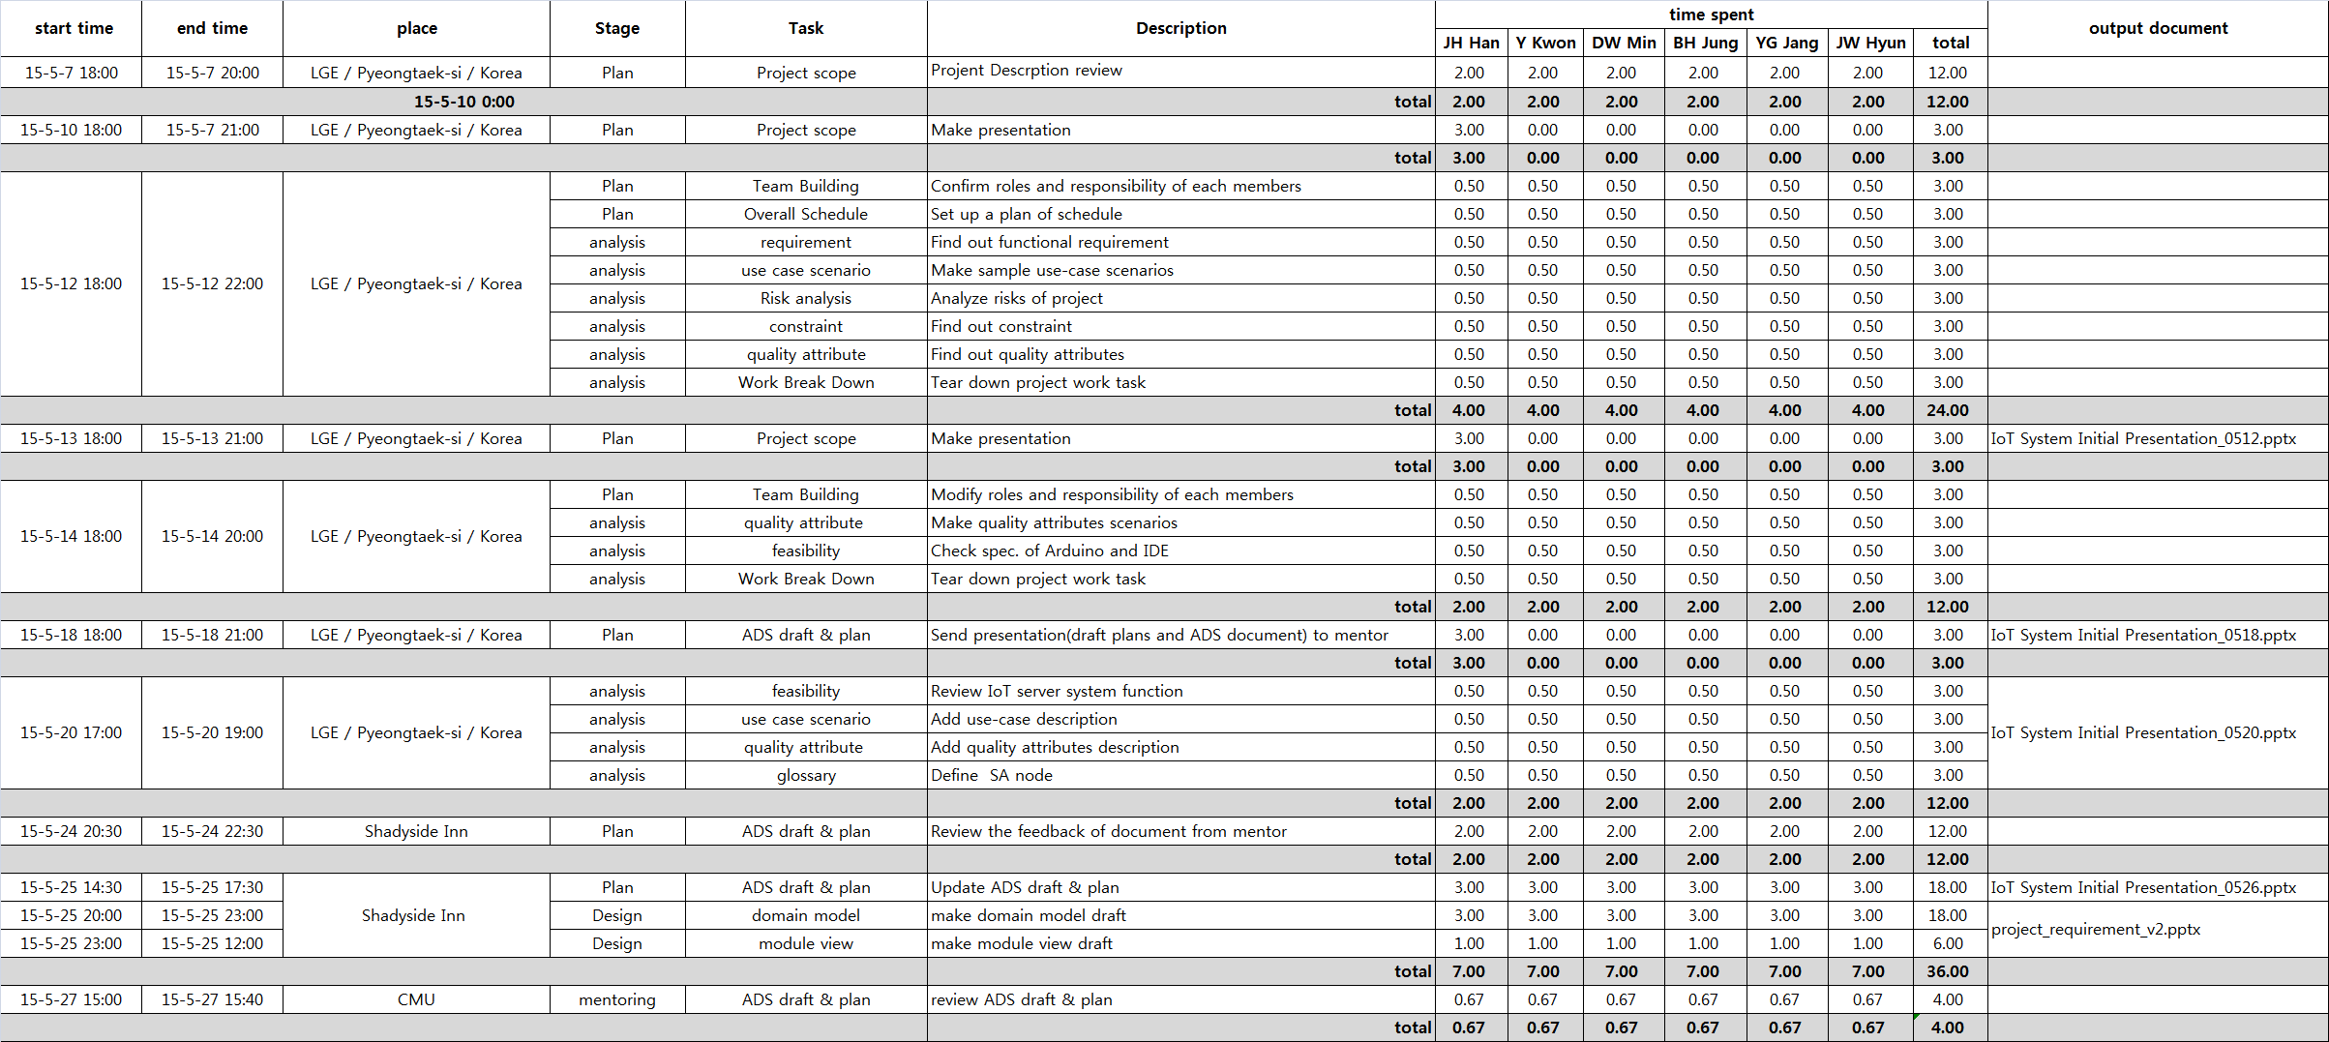
4.7 Time Logs

Slide 37
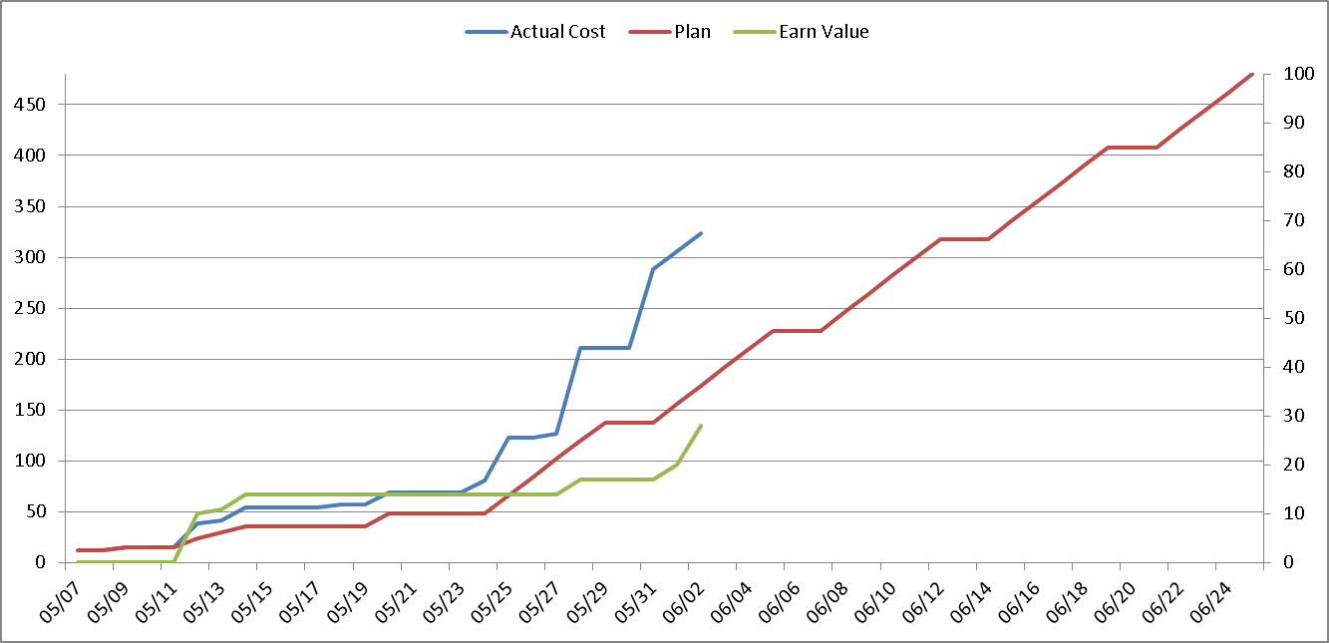
4.8 Earn Value

Slide 38
5. Design
5.1. System Context Diagram
5.2. Module View

Slide 39
5.1 System Context Diagram
Node
IoTMS
<< Display information >>
User Authorization Success / Fail
Node Authorization Success / Fail
Set Rule Success / Fail
Display Log information
- Node information
- Node information for registration
Sensing Data : Temperature/Humidity/Door /Presence(proximity)/Mail Box
Command :
Door on/off, light on/off,
alarm on/off
- Register node
Log In
Register User
Add, Delete Node
Set Customize rule
Log information
Set Alarm mode (Secure / Unsecure)
Door on/off
- Light on/off
: System Element
: User
: Data flow
: User action(Event) to IoTMS

Slide 40
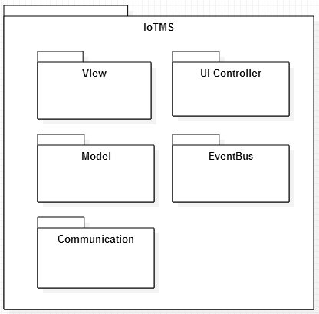
5.2 Module View
Decomposition Style of IoTMS
IoTMS has 5 modules as following
View : Display User Interface
UI Controller : Control user command and include logic
Model : Logic implementation
EventBus : Communicate between
UI Controller and Model
Communication : Communicate betw-
een Model and SA Node
Static Perspective
: Package
(Class or Set of
Classes)

Slide 41
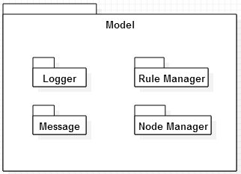
5.2 Module View
1st decomposition of Model module
Model module has 5 sub-modules as following
Logger : Logging user command or sensor values
Rule Manager : Manage pre-defined rule and custom rule defined by user
Node Manager : Manage nodes and things
Message : E-mail and SMS object for
sending emergency messages
Static Perspective
: Package
(Class or Set of
Classes)

Slide 42
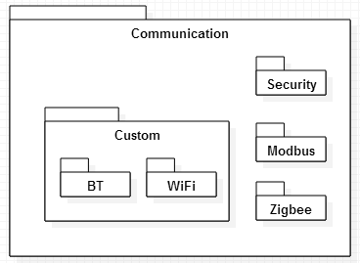
5.2 Module View
1st decomposition of Communication module
Communication module has 4 sub-modules as following
Security for Network : Security Library for communicating
Modbus : to support Modbus
Zigbee : to support Zigbee
Custom(BT and WiFi) : to support
Bluetooth and WiFi
Static Perspective
: Package
(Class or Set of
Classes)

Slide 43
5.2 Module View
1st decomposition of View module
View module has 3 sub-modules as following
User View : Display user log-in and management view
Rule View : Display rule management view
Node View : Display node control/monitoring view
Static Perspective
View
User View
Rule
View
Node
View
: Package
(Class or Set of
Classes)

Slide 44
5.2 Module View
1st decomposition of UI Controller module
UI Controller module has 3 sub-modules as following
User Controller : is mediator between user view and database
Rule Controller : is mediator between rule view and rule manager
Node Controller : is mediator between node view and node manager
Static Perspective
UI Controller
User Controller
Rule
Controller
Node
Controller
: Package
(Class or Set of
Classes)

Slide 45
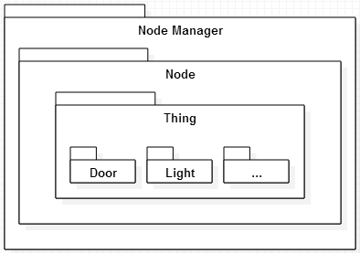
5.2 Module View
2nd decomposition of NodeManager module
NodeManager module has 2 sub-modules as following
Node : Manage nodes. Node can be none or one more.
Thing : Manage Things which is included Node. Things can be none or one more.
Static Perspective
: Package
(Class or Set of
Classes)

Slide 46
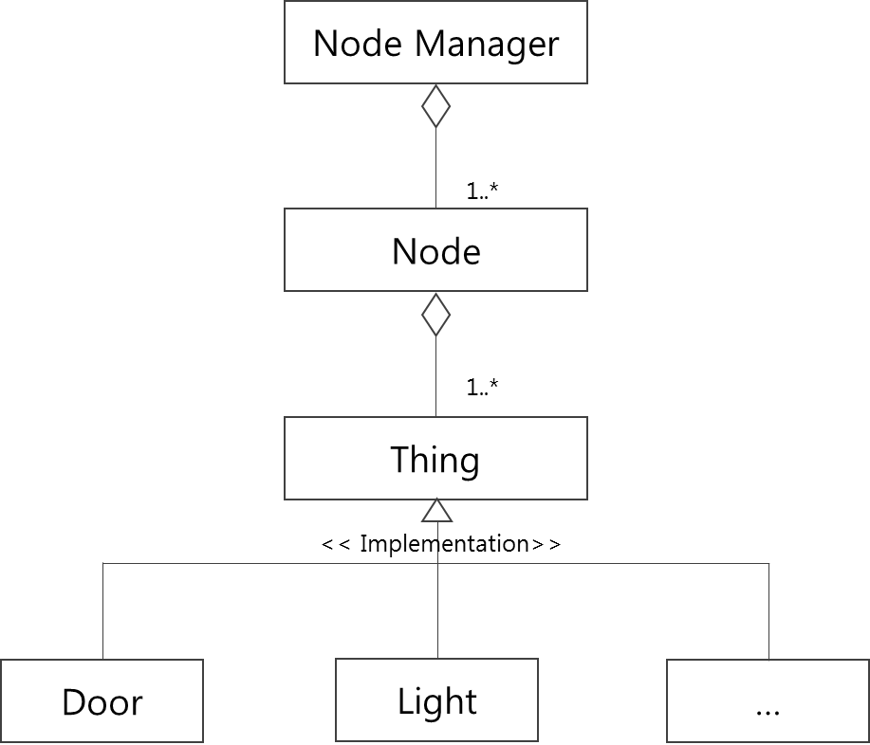
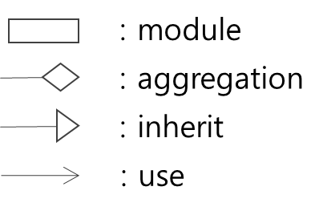
5.2 Module View
Generalization style of NodeManager module
NodeManager
Static Perspective

Slide 47
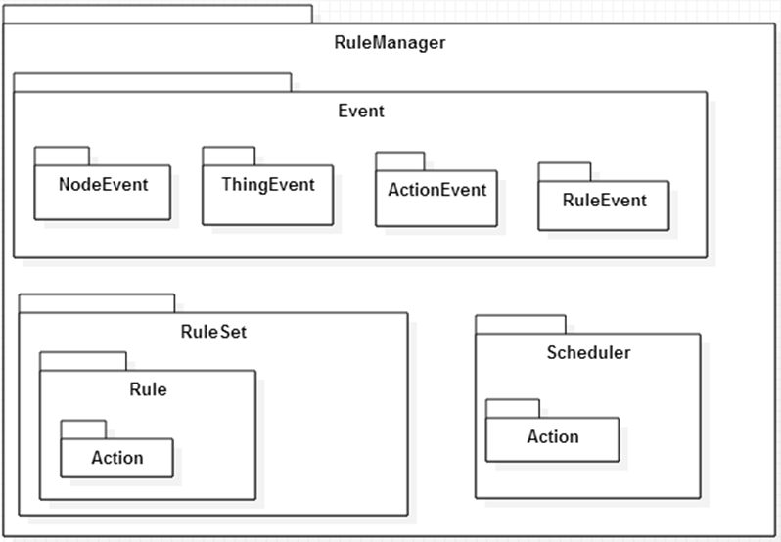
5.2 Module View
2nd decomposition of RuleManager module
RuleManager module has 3 sub-modules as following
Event : Manage events from other modules and tirgger changes on RuleSet.
RuleSet : Set of rule. Manage changes on rules; add/delete/search rules and active/de-active .
Scheduler : Manage delayed actions which bind time condition. Delayed actions can be canceled.
Static Perspective
: Package
(Class or Set of
Classes)

Slide 48
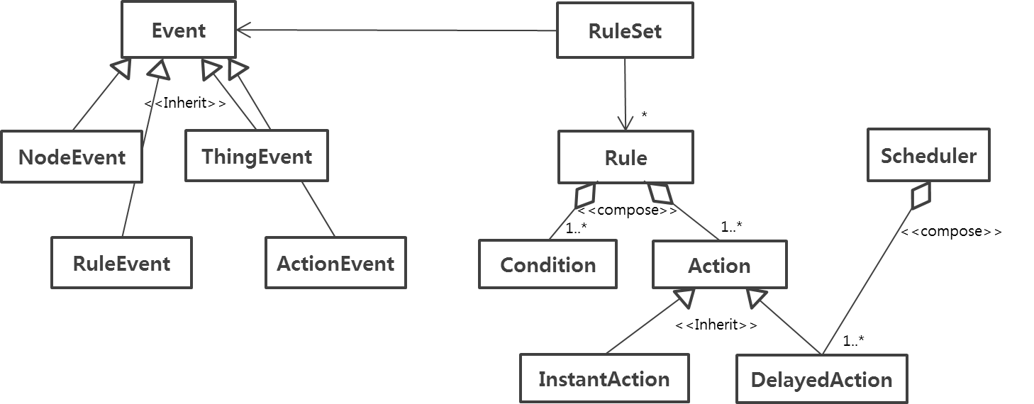
5.2 Module View
Generalization of RuleManager module
RuleManager
Static Perspective

Slide 49
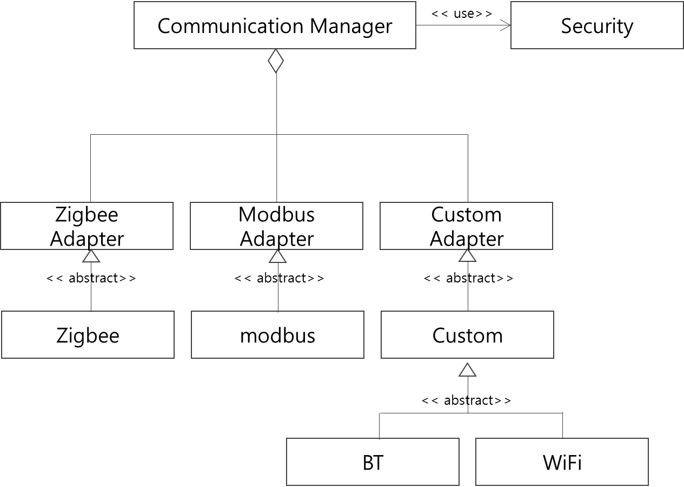
5.2 Module View
Generalization of Communication module
Communication
Static Perspective

Slide 50

Questions

